Slide 1
Retro Game Demonstration
By Jasper McNiven, Kriti Tripathi, Septian Razi and Yatindra Tripathi

Slide 2
Introduction
Space Crusaders
Inspired by Flappy Birds
Theme – space
Simple implementation allowed for additional features
Designed our own obstacles and character
Unique features

Slide 3
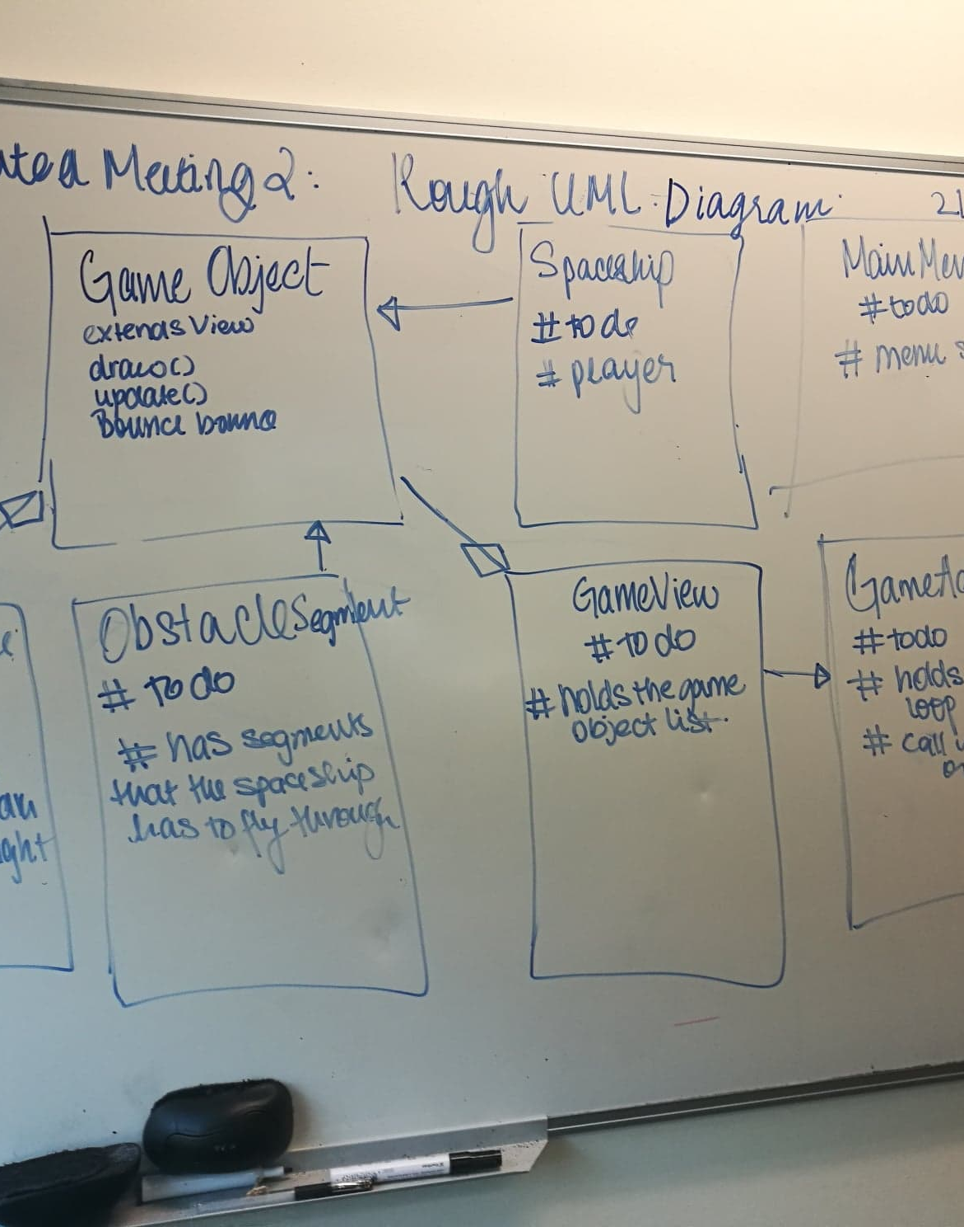
Our Group
Weekly meetings
5 accounted minuted meetings
Initially divided into 3 parts – UI, assets, logic (collision) Video recorded progress

Slide 4
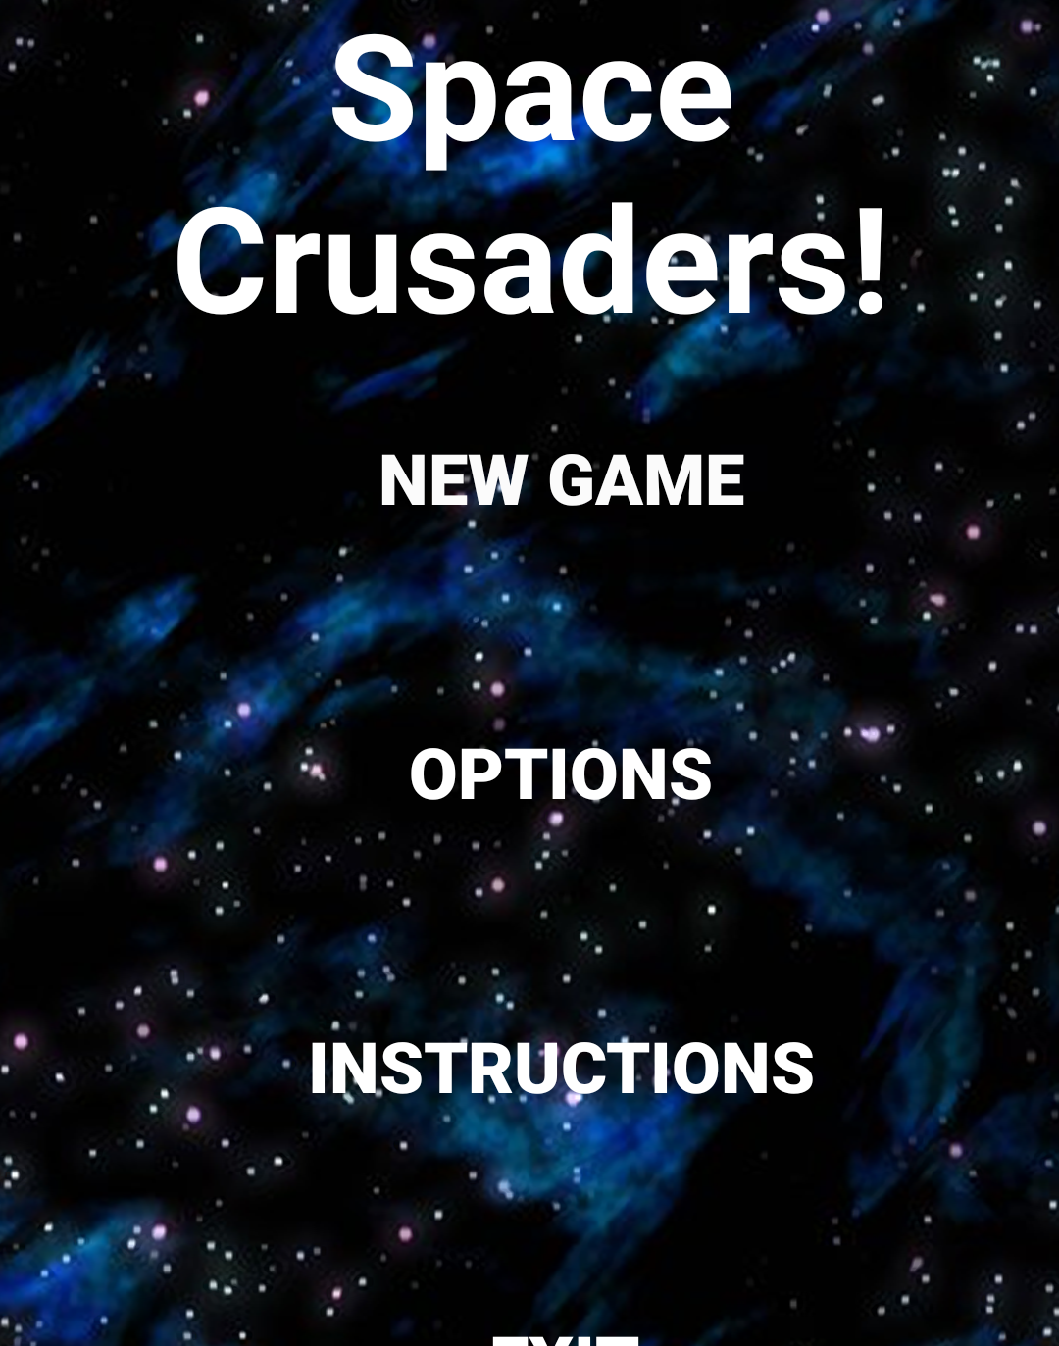
Overview
The aim - jump through/avoid obstacles
Collect coins to gain additional points
Speed increases as game progresses
Indefinite game
End of game – when player crashes/collide

Slide 5
Demonstration

Slide 6
Design Approach
Assignment separated into four parts:
Activities
Logic
Sound and Music
Visual and Graphics
Object oriented design approach
Base class – GameObject extended by all other classes
Attempt at an observer design pattern

Slide 7
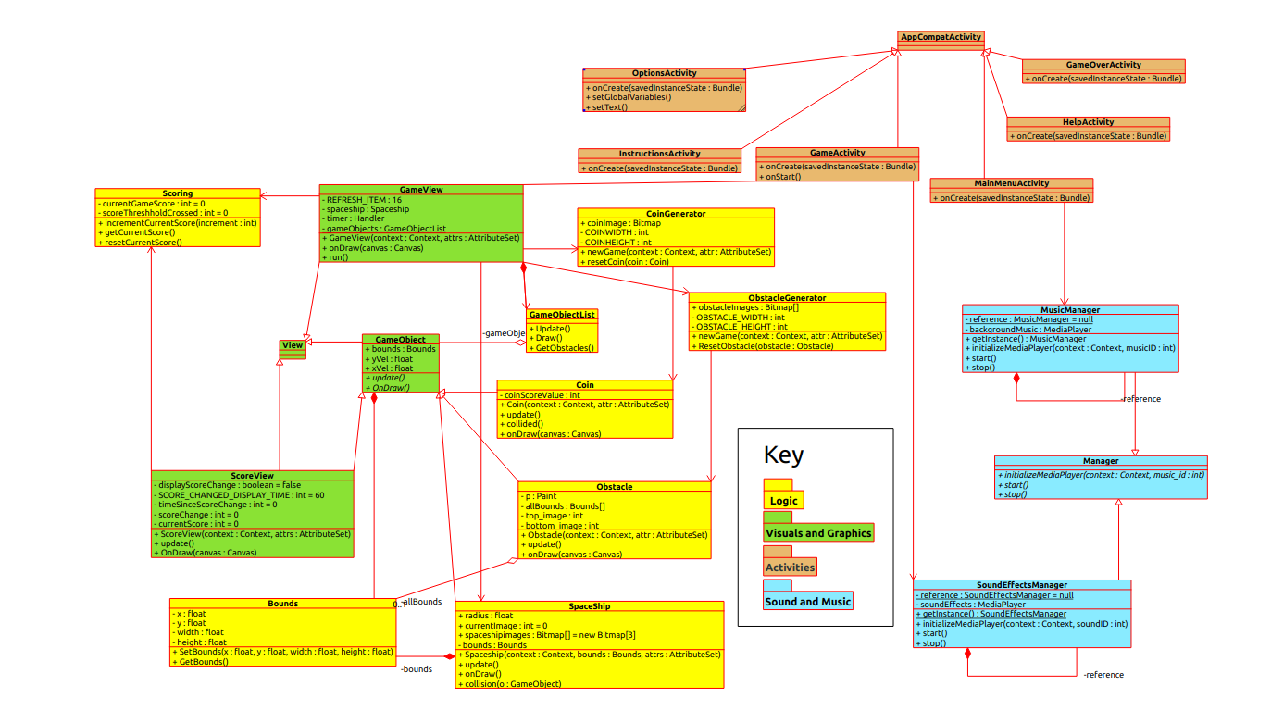
UML Diagram

Slide 8
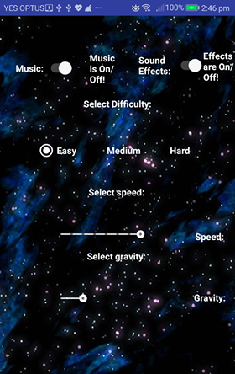
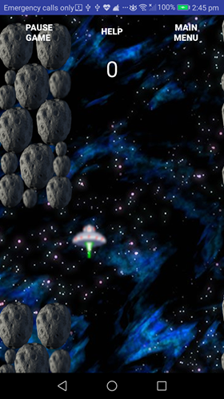
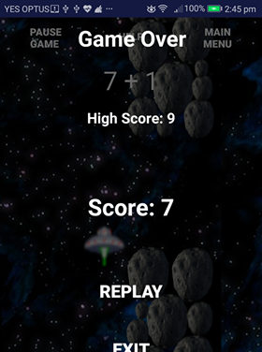
User Interface
Modern GUI
Saved preferences
Effects/music – on/off

Slide 9
Logic
Modules implemented individually
Brought together in the end
Ex – collision, obstacle generation. etc
Appropriated into the game
GameObject – key class

Slide 10
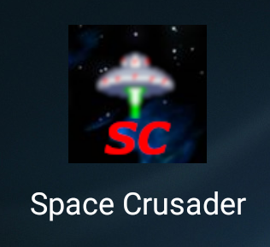
Graphics and Sounds
Scrolling backgrounds
Game images/sounds
Use of Gimp

Slide 11

Testing
Junit tests
Many types of testing carried:
Blackbox testing - obstacle generator working as expected
Whitebox testing – tests to check collision of the space ship with obstacles (with good coverage)
Integration testing – sample simulation of the entire game
Manual testing – frequently playing the game, crashing the player intentionally to ensure game over features work, etc.

Slide 12
Improvements, Extensions and Optimisation
Improvements to:
Design approach: adopted façade/decorator pattern, better plan and modularised it better
Implementation: Use SoundPool instead of MediaPlayer, bitmaps for saved preferences using a separate cache class, etc.
Time management/milestones: implementation of collision which is the heart of the game and hence delayed everything else.
Extensions easily added as a result of our chosen design approach

Slide 13

Questions ???

Slide 14

Thank you

